Slide 1
Data Structures
CSE207
Md. Manowarul Islam
Dept. of CSE, Jagannath University

Slide 2
Stack
It is a linear data structure consisting of list of items.
In stack, data elements are added or removed only at one end, called the top of the stack.
Stack: AAA, BBB, CCC, DDD, EEE
0
1
2
3
4
5
6
AAA
BBB
CCC
DDD
EEE
Top
Figure: Diagrams of Stacks

Slide 3
Stack
Two basic operations are associated with stack:
“Push” operation is used to insert an element into a stack.
“Pop” operation is used to delete an element from a stack.
6
5
EEE
4
DDD
3
CCC
2
BBB
1
Stack: AAA, BBB, CCC, DDD, EEE
AAA
0
Top

Slide 4
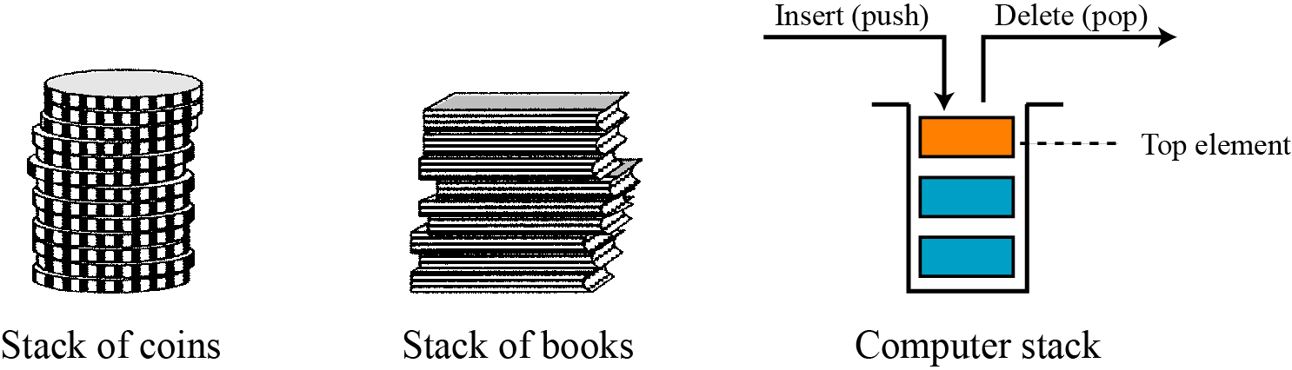
Stack
A stack is a restricted linear list in which all additions and deletions are made at one end, the top.
If we insert a series of data items into a stack and then remove them, the order of the data is reversed.
This reversing attribute is why stacks are known as last in, first out (LIFO) data structures.

Slide 5
Stack
Stack has only two operation
Push: insert data on top
Pop: remove data from top
Also known as LIFO structure
Last In First Out
4
3
2
1
Empty Stack

Slide 6
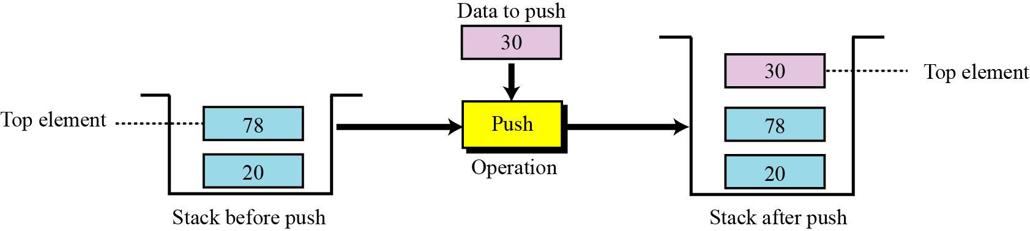
The push operation
The push operation inserts an item at the top of the stack. The following shows the format.

Slide 7
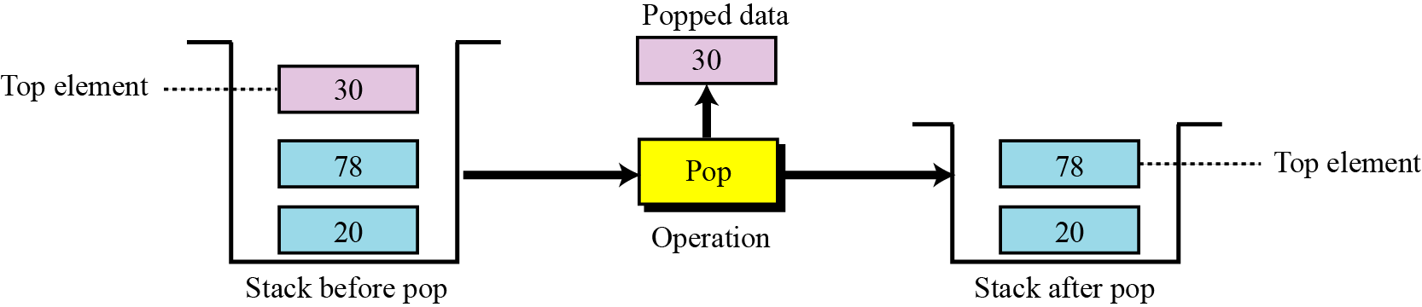
The pop operation
The pop operation deletes the item at the top of the stack. The following shows the format.

Slide 8
Error checking
There are two stack errors that can occur:
  Underflow: trying to pop (or peek at) an empty stack
  Overflow: trying to push onto an already full stack

Slide 9
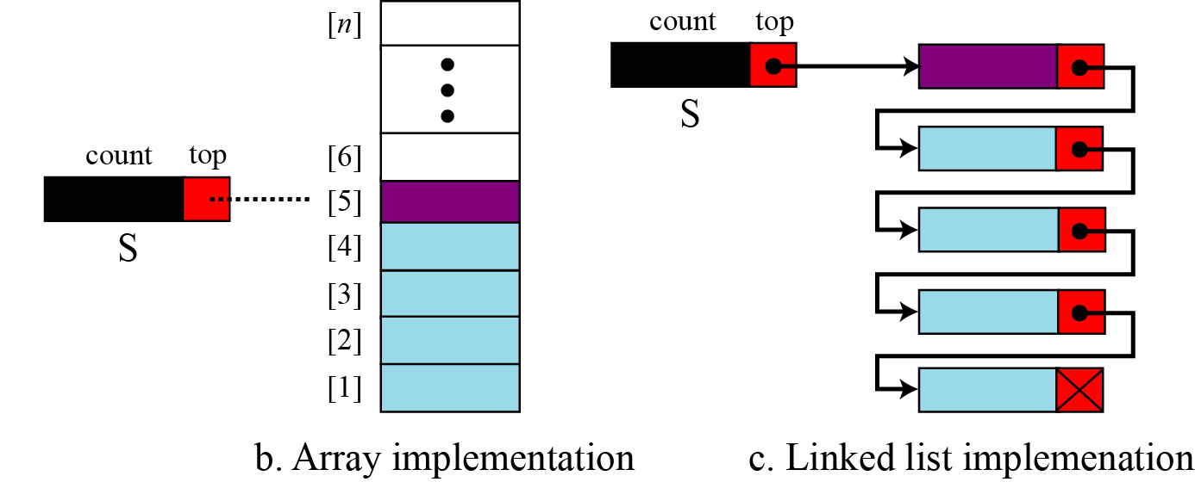
Implentation

Slide 10
Algorithms for Push and Pop
Stack is the place where to store data.
Top represents in which location the data is to be inserted.
MaxSTK is the maximum size of the stack and finally, Item is the new item to be added.

Slide 11
For Push Operation
If Top = MaxSTK then Print: Overflow and Return. /*…Stack already filled..*/
Set Top := Top +1
Set Stack[Top] := Item
Return.

Slide 12
For Pop Operation
If Top = -1 then Print: Underflow and Return. /*…Stack already Empty..*/
Set Item := Stack[Top]
Set Top := Top - 1
Return.

Slide 13
Some uses of stacks
Stacks are used for:
  Any sort of nesting (such as parentheses)
  Evaluating arithmetic expressions (and other sorts of expression)
  Implementing function or method calls
  Keeping track of previous choices (as in backtracking)

